Slide 1
Montgomery County Redistricting Commission
The process to map new Council districts for future Council elections

Slide 2
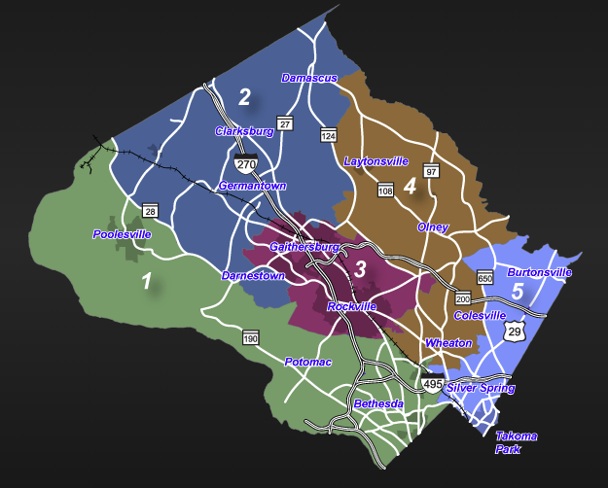
Why is a new map of Council districts needed?
Beginning in 2022, the number of Council districts will increase from 5 districts to 7 districts
The new districts must be drawn based the current (2020) population
The Council Charter (the County’s Constitution) requires redistricting every 10 year…the last redistricting was approved in 2011

Slide 3
What is the Commission’s mission
Recommend to the Council the adoption of a map of 7 Council Districts from which voters in those district will have the opportunity to cast ballots for one District Councilmember and 4 at-large Councilmembers. The Commission must report to the Council by November 15, 2021.
The Districts must be substantially equal in population…approximately 150,000 residents in each districts
Districts should be compact and contiguous … a district may not be composed of “islands” of land area.
Ethnic and racial groups must be identified to avoid diminishing their voting rights by either packing those populations in a single district or splitting those populations in a manner that dilutes their impact on elections

Slide 4
Commission “Ground Rules” for Mapping
Equal Population: Equal Protection Clause of the Fourteenth Amendment requires that the legislative districts across states be equal in population.
Compactness: Having the minimum distance between all the parts of a constituency (a circle, square or a hexagon is the most compact district).
Contiguity: All parts of a district being connected at some point with the rest of the district.
Minority Representation: Consideration of areas of population with majority of minorities.
Preservation of Counties and other Political Subdivisions: This refers to not crossing county, city, or town, boundaries when drawing districts.
Preservation of Communities of Interest: Geographical areas, such as neighborhoods of a city or regions of a state, where the residents have common political interests that do not necessarily coincide with the boundaries of a political subdivision, such as a city or county.

Slide 5
The Planning Department has received the 2020 census data from the State.
Planning staff expect to have the mapping tool for Commissioners updated with the 2020 census data ready for use by Commissioner’s on September 15th. The Commissioners will then start the map drawing process.
For the Public – the Census Bureau Announces Release Date for Easier-to-Use Formats for Redistricting Data
The U.S. Census Bureau will release easier-to-use formats of the 2020 Census Redistricting Data (Public Law 94-171) Summary File on September 16.
Also on September 16, redistricting data will be available through the Census Bureau’s primary data dissemination tool, data.census.gov. The Census Bureau will also deliver an easy-to-use toolkit of DVDs and flash drives to state officials and public bodies responsible for their state’s legislative apportionment or districting.
These data — first released August 12 — are currently available in a legacy format on the Census Bureau’s FTP site. These data are also available through various data visualizations.

Slide 6
How can you help?
What communities should be located in a single district?
What communities should be in separate districts?
Are there boundaries between district that you would recommend?
Information on Commission:
The Redistricting Commission will meet September 23 and every Wednesday in October at 5:00pm.
Meetings are Livestreamed on the Council FaceBook page (you do not need a FaceBook account to view)
Redistricting Commission webpage for meeting notice, agenda and minutes can be found at: https://www.montgomerycountymd.gov/COUNCIL/BCC/redistricting/index.html

Slide 7
Resource Slides

Slide 8
2000-2020 Census, US Census Bureau and Montgomery Planning Research & Strategic Projects Division

Slide 9
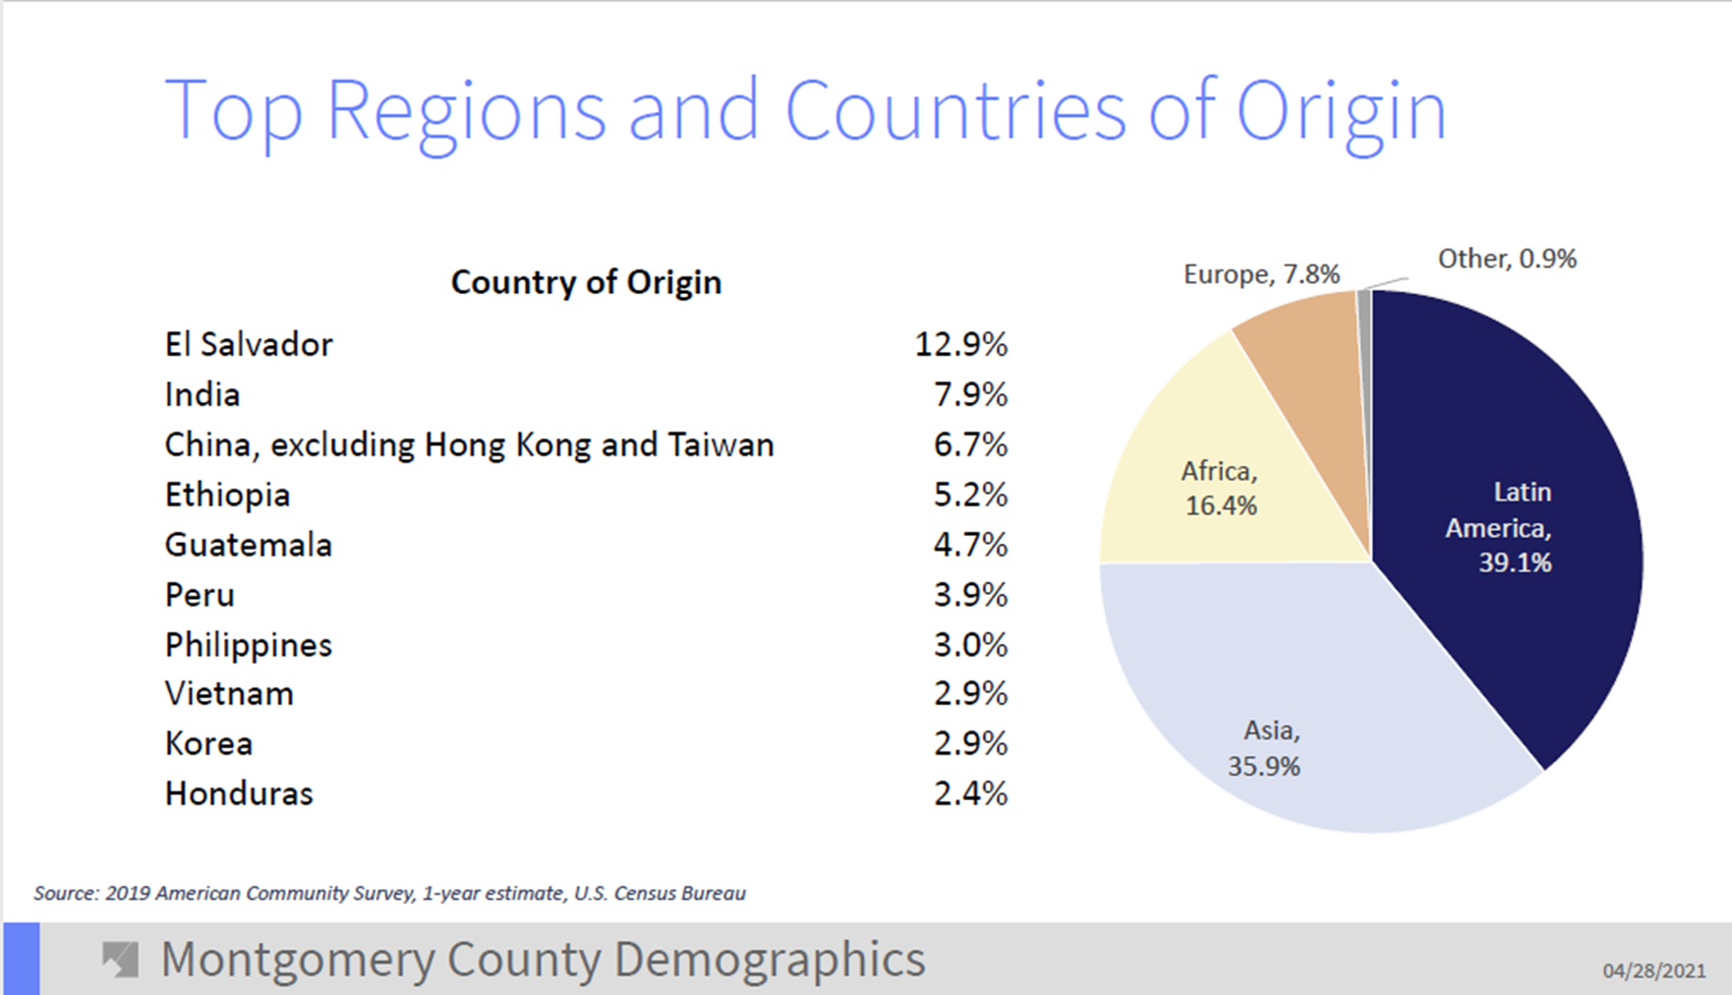

Slide 10
Racial and Ethnic Diversity
2000-2020 Census, US Census Bureau and Montgomery Planning Research & Strategic Projects Division

Slide 11
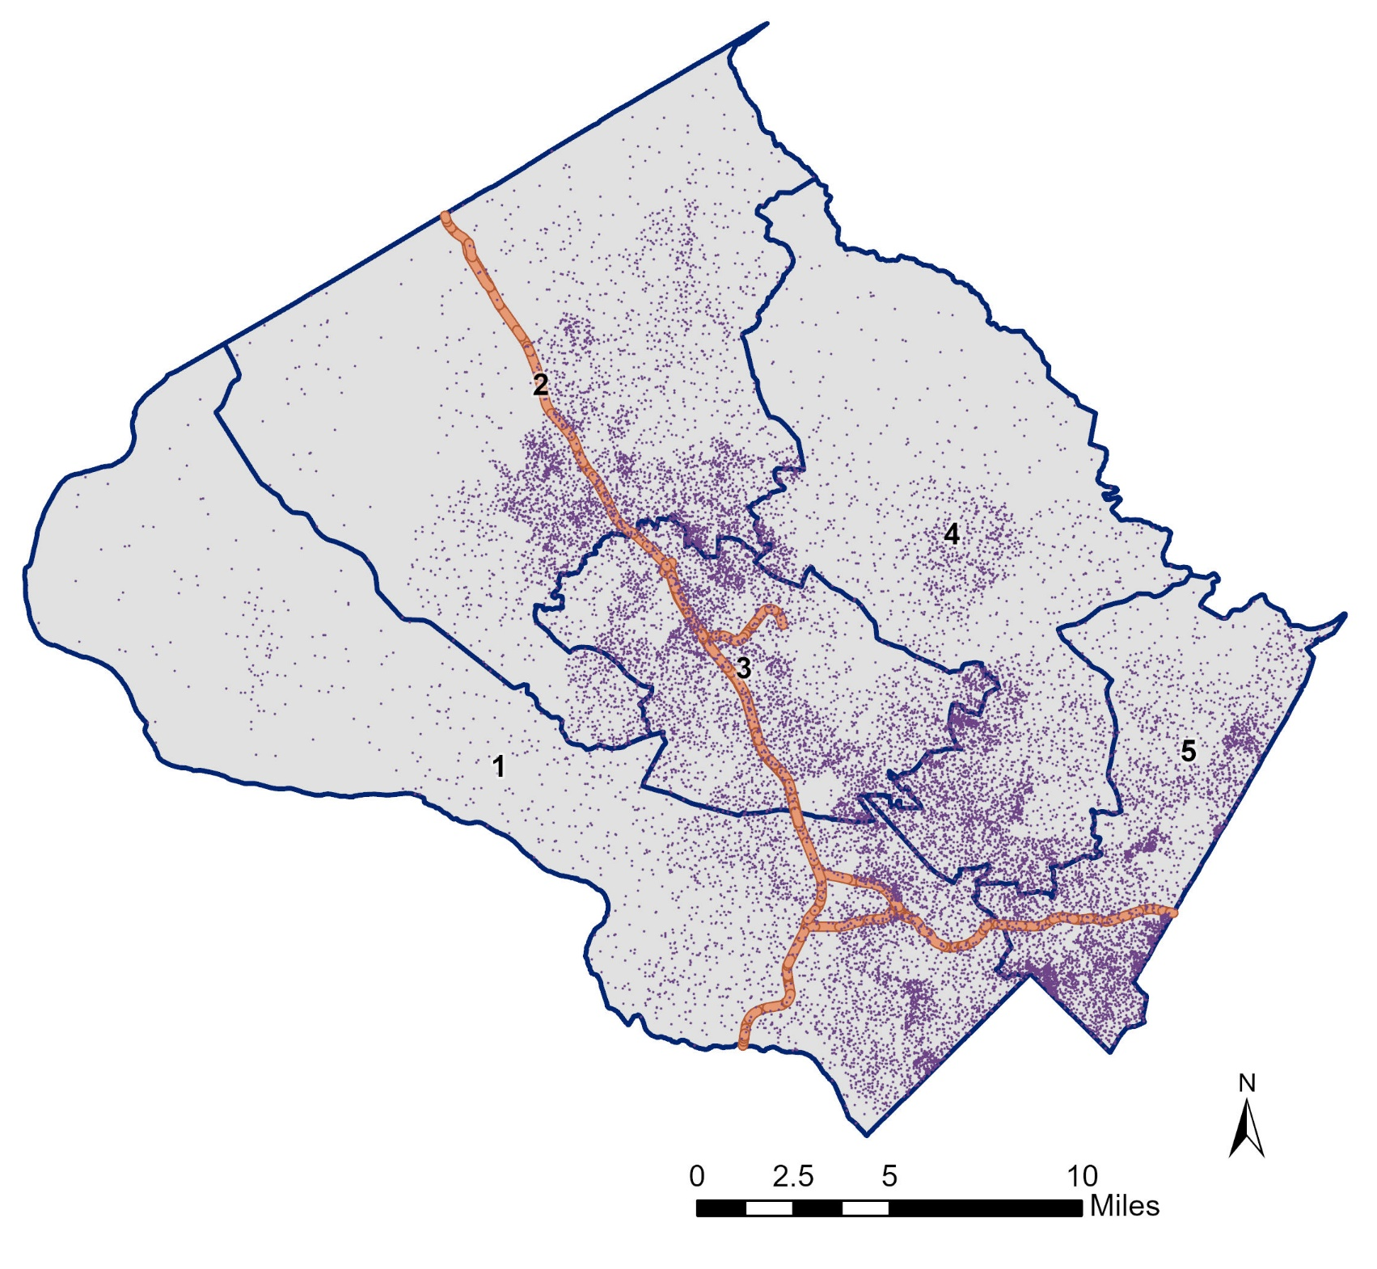
Population by Place
Source: 2019 American Community Survey, 5-year estimate, U.S. Census Bureau

Slide 12
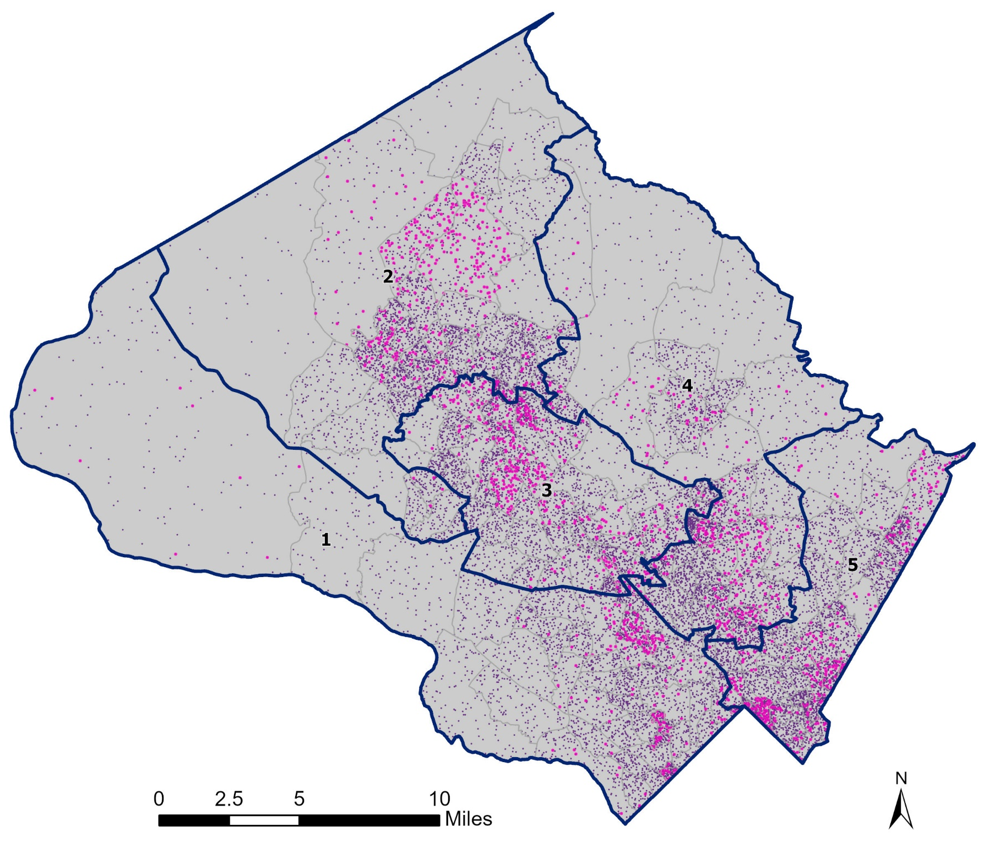
Growth by Place
2010 – 2019 Clusters of Growth
Source: 2019 American Community Survey, 5-year estimate, U.S. Census Bureau

Slide 13
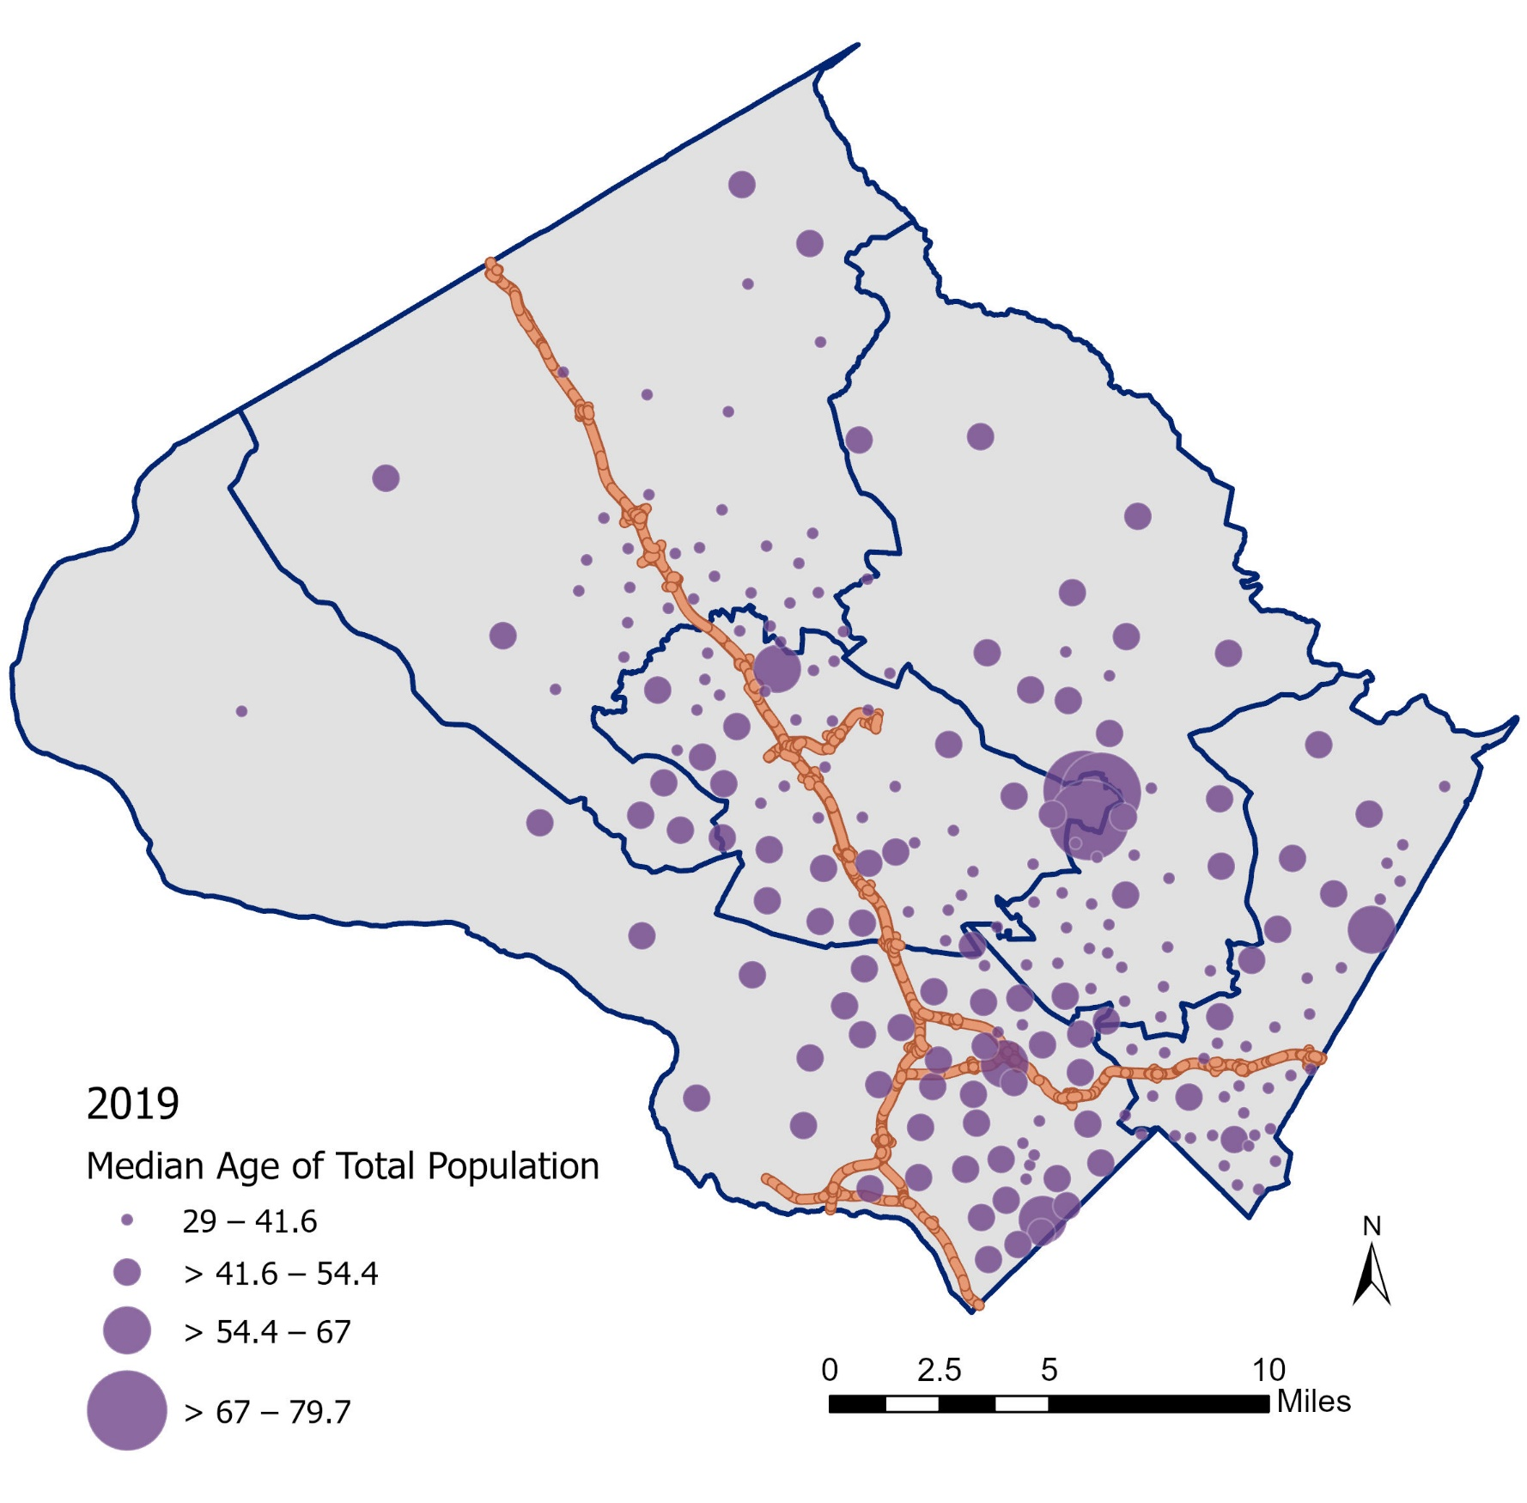
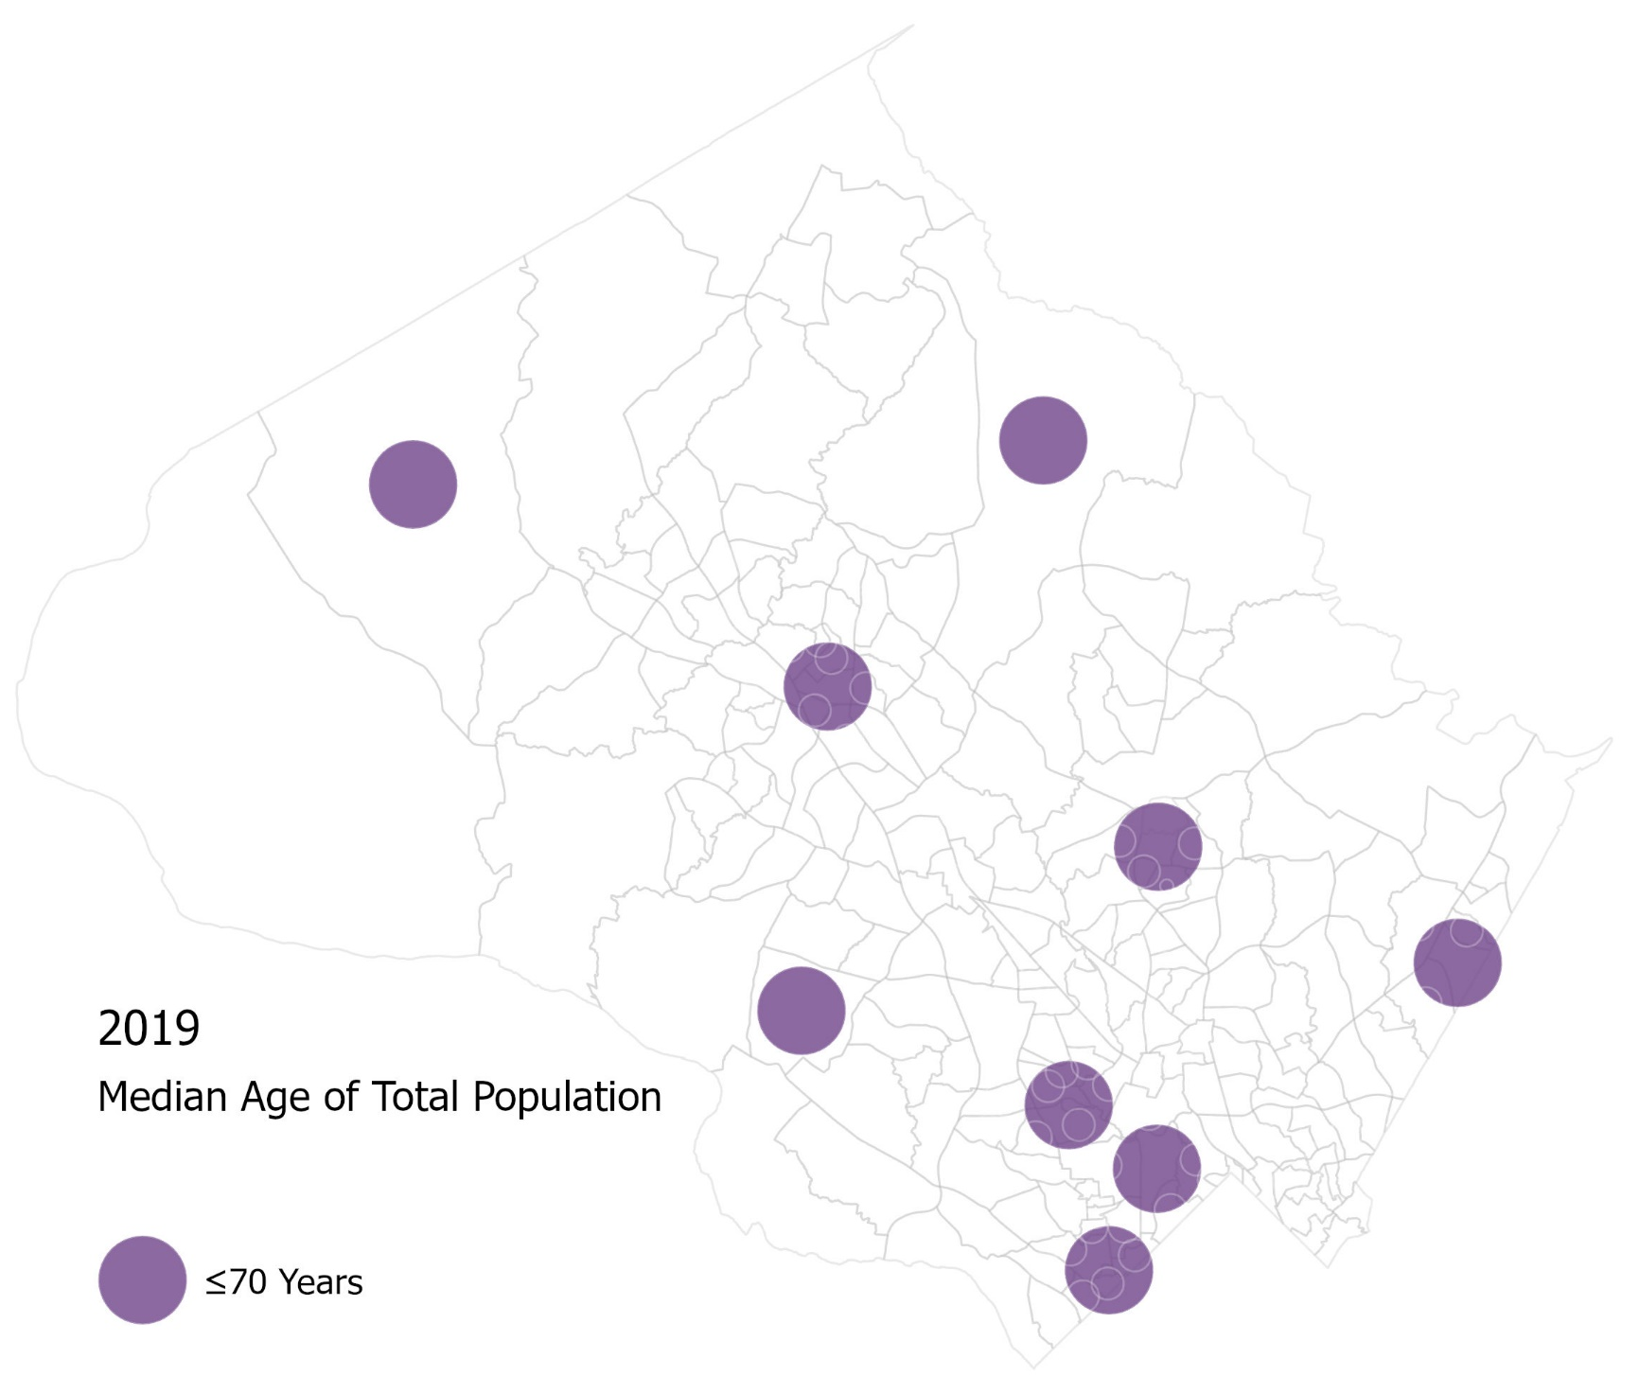
Median Age by Place
Countywide Median Age: 39.2 Years
Leisure World
Source: 2019 American Community Survey, 5-year estimate, U.S. Census Bureau

Slide 14
Montgomery County census tracts 1990-2019
Things to observe
    Tract sizes are different (larger = less populated)
    Whiter and less dense farther upcounty
    Less racial predominance downcounty, eastern, and along I-270 corridor
    Generally becoming more diverse (no racial predominance)
    Tracts becoming “Minority-majority”
Notes:
Before we jump into the maps, here are some things to observe…

Slide 15
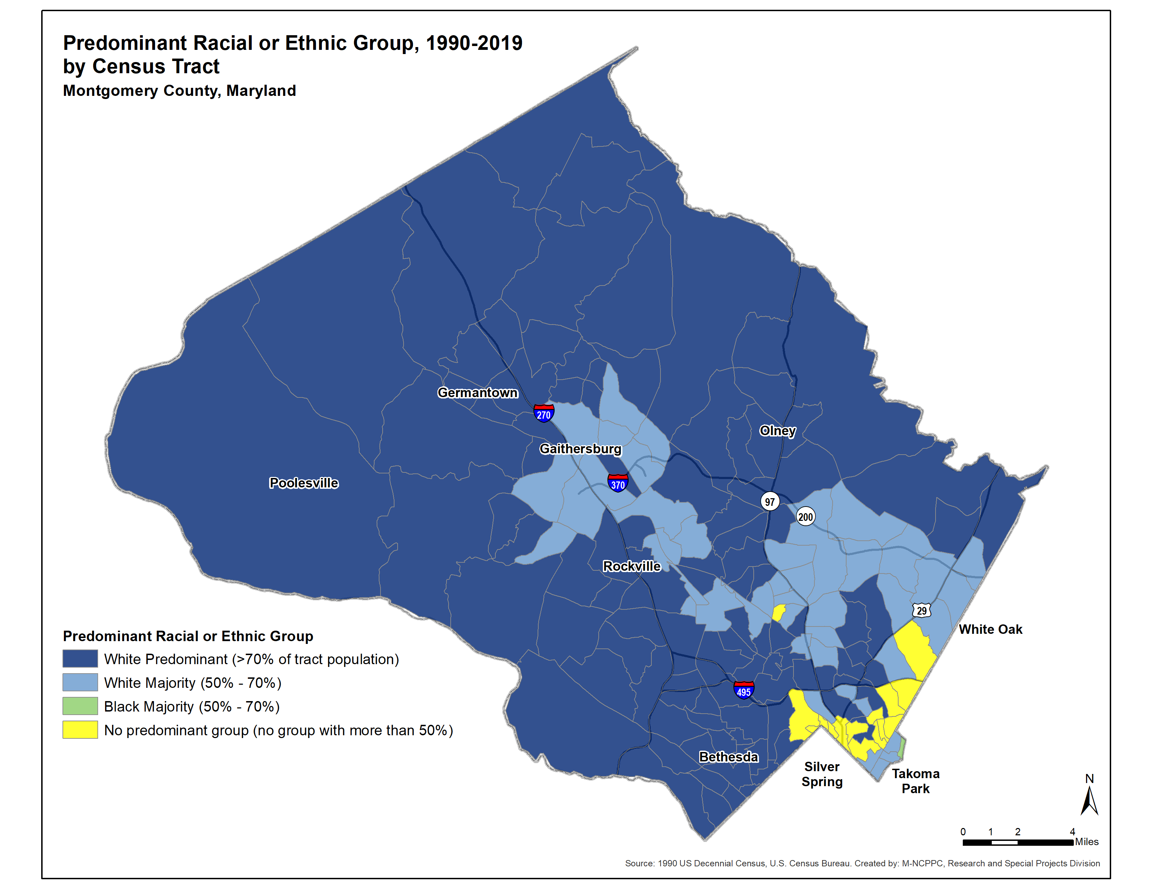
1990
Notes:
Map: Note to look at blue becoming lighter (less white predominance), more green in east (black majority), and more yellow throughout (no predominance)
Top graph (People): Note to look at first bar (white %)
Bottom graph (Land, by race): Note to look at last bar (no predominant race)

Slide 16
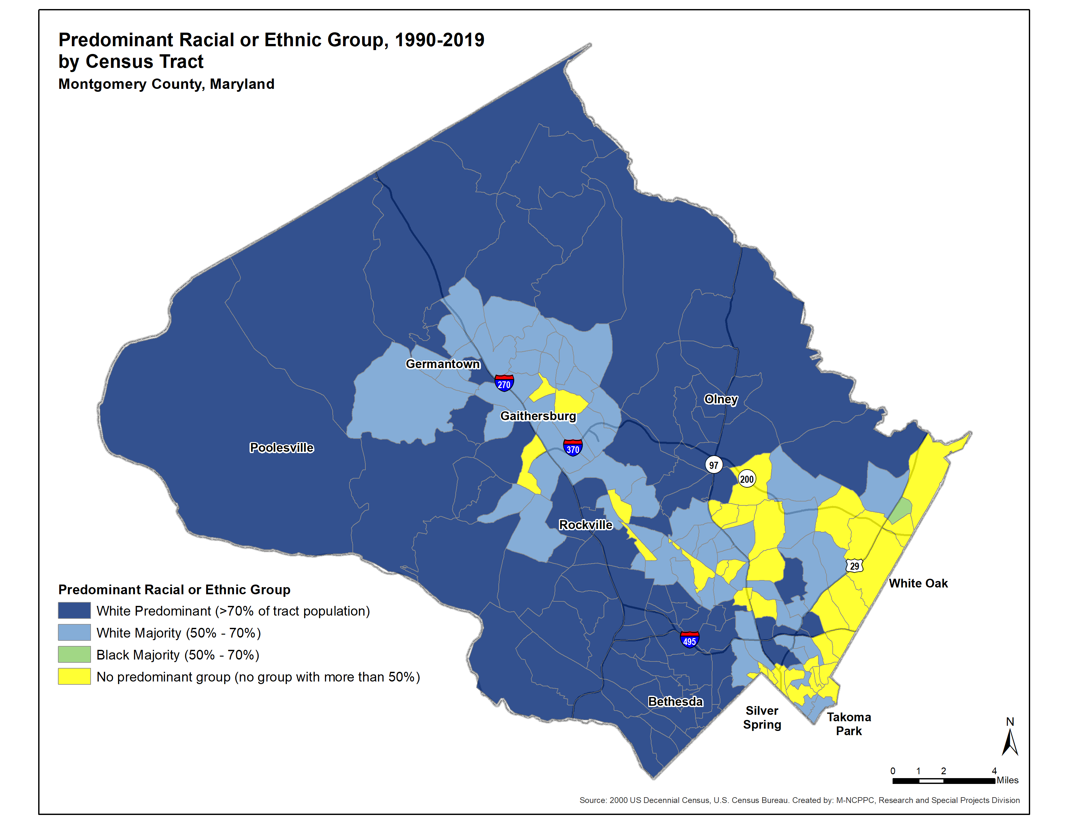
2000
Notes:
Eastern edge, Wheaton, & Gaithersburg/Rockville

Slide 17
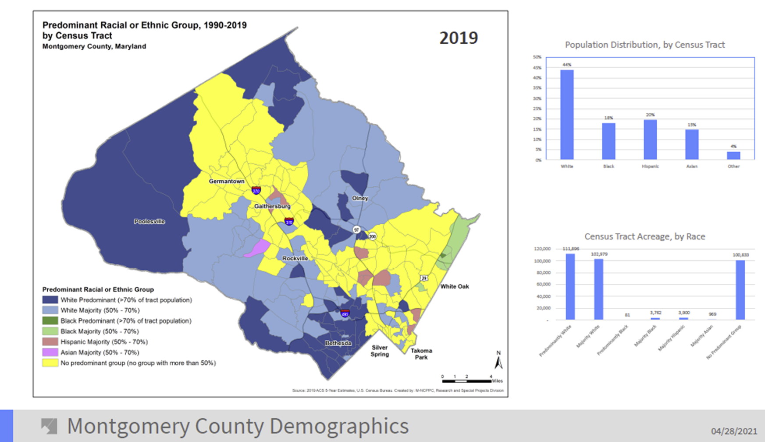

Slide 18
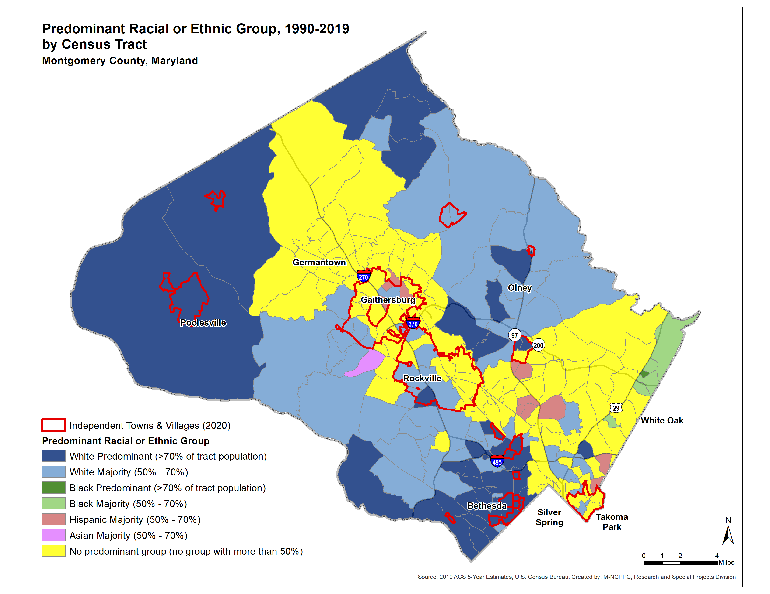
2019

Slide 19

2019

Slide 20





Demographic Changes Summary
Age:
Over 65 Population is up and rising
Under 5 Population is falling, as are birth rates
The younger population is more diverse
Race/Ethnicity:
Increasing diversity but geographic segregation along racial lines
Income/Race are correlated and share a geographic pattern

Slide 21
How can you help?
What communities should be located in a single district?
What communities should be in separate districts?
Are there boundaries between district that you would recommend?
Information on Commission:
The Redistricting Commission’s next meeting is Thursday September 23d 5:00pm.
Meetings are Livestreamed on the Council FaceBook page (you do not need a FaceBook account to view)
Redistricting Commission webpage for meeting notice, agenda and minutes can be found at: https://www.montgomerycountymd.gov/COUNCIL/BCC/redistricting/index.html

